Slide 1

Problem:
Forgetful
Busy
Convenience
Notes:
People are forgetful and busy, and checking a calendar app all day isn't convenient. Most of us already live in our texts, so the assistant meets you there.

Slide 2
Beacon
By: Ethan Nelson
Notes:
A personal assistant you text over iMessage. Sign up on a web page, connect Google Calendar, then just text it. No app to download.

Slide 3

Daily Refreshers:
Every Morning
Your Schedule
Stay Ahead
Notes:
Pick a time when you sign up and the assistant texts you a daily briefing: today's events and when you need to leave. Turn it off any time by texting it.

Slide 4



Reminders:
Notes:
Reminders before each event, with the time, how long until it starts, and the location. If an event is moved or cancelled, the reminder follows it. You can also say 'remind me to...' for anything else.

Slide 5



Create, Edit, and Remove Events:
Create
Edit
Remove
Notes:
Text something like 'move lunch to 1pm'. The assistant proposes the change, warns about conflicts and suggests free times, and only saves it after you reply yes in a new message.

Slide 6

Invite Friends:
Add Guests
Saved Contacts
Email Invites
Notes:
Invite people to an event by name. It looks them up in your saved contacts, shows the exact email first, and Google sends the invite once you confirm.

Slide 7

Destinations:
When to Leave
Live Traffic
Places Nearby
Notes:
Ask 'when should I leave?' and it uses Google Maps with traffic from your home address. It can also find restaurants and things to do near you or near an event.

Slide 8

Memories:
Preferences
Contacts
Notes
Notes:
Tell it things to remember, like preferences or a friend's email. Each person's memory is private and encrypted; nobody else's assistant can see it.

Slide 9
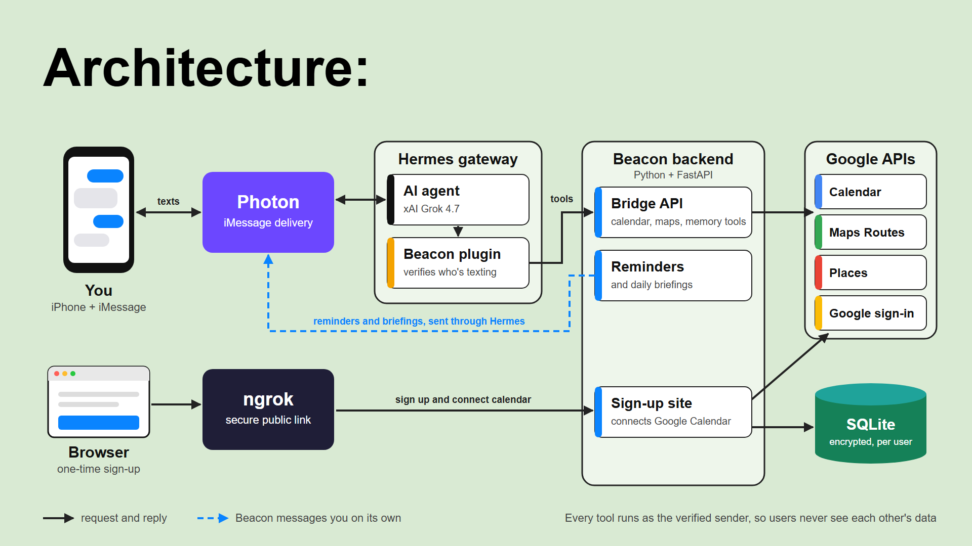

Slide 10
Questions?
Notes:
Thank you! Happy to show a live demo.

